Slide 1
Visual Thinking Process
Presented By – Jugal, Kaleem, Nilesh.

Slide 2
Overview
Colin wares “Visual thinking process” describes the various components of the eye-brain system, and how one can better engage the gifts of evolution to garner results, at least visually.
Ware’s main goal is to set up an environment to optimize cognitive algorithms so that the analyst can get to meaningful answers quicker.
Ware mentions the methods for hunting for food in animals is akin to how humans hunt information.

Slide 3
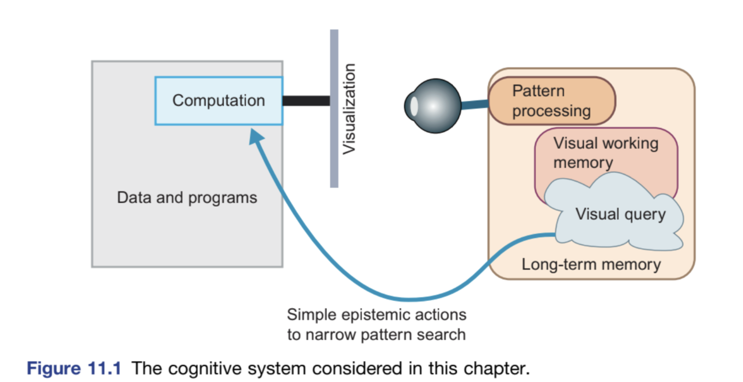
The Cognitive System
Wares overview of human cognitive system.
Ware talks about the different facets of human cognition. Detailed below is a simple search operation executed via epistemic(retinal) search.

Slide 4
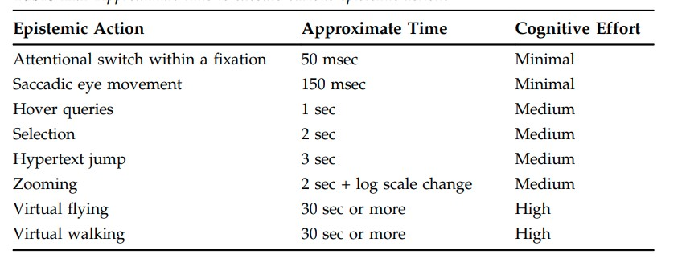
The cognitive systems unit.
Fixations – epistemic / verbal/ visual
Fixations in the context of visual processing

Slide 5

Cognitive System Example

Slide 6
Cognitive System Example
I want to ask why you people identified the snake, if at all.
This identification of potential danger is quintessentially human, especially snakes.
Ware tries to break down the process that you used to id the snake, and tries to apply it to better visualization techniques.

Slide 7
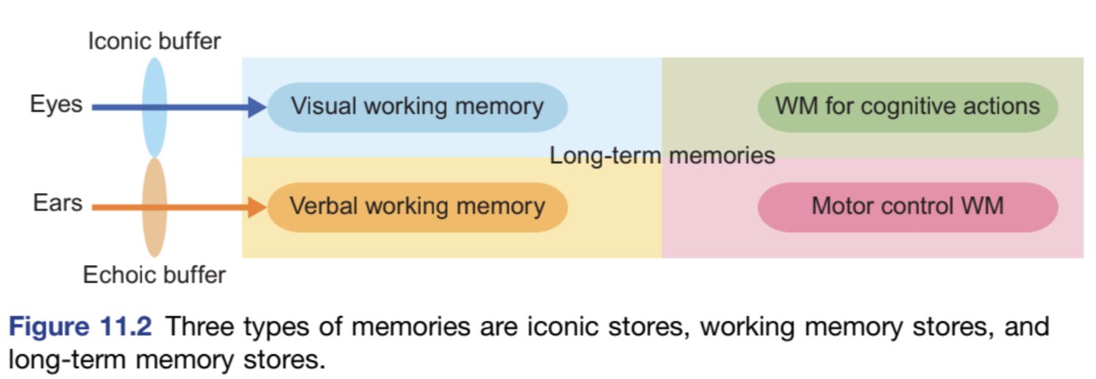
Memory and Attention
Memory hierarchy according to ware is - iconic stores, working memory stores and longterm memory stores

Slide 8
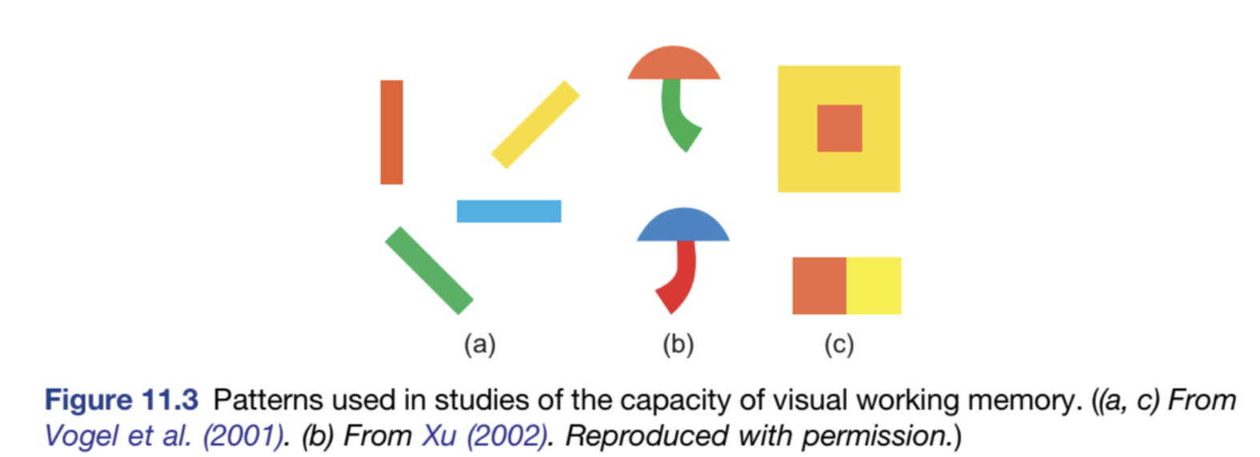
Memory and Attention
Ware talks about images on the retina and how quickly they disappear, usually within milliseconds, this is image related information, colour, shape along that ilk.

Slide 9
Working Memory and Visual Working Memory.
Working memory stores sequences of cognitive instructions for accomplishing the task at hand.
The modern take on working memory is that of potential activation loops, the best-case activation loop with the best set of “instructions” win and then after execution and review, it is transferred to long term memory.
Visual working memory is the info retained from one fixation to the next.

Slide 10
Limitation of visual working memory
Ware talks about the literature surrounding visual working memory, saying that information such as abstract shapes, texture and context where the information is found, on top of things such as position is processed.
Its like a capacitor, stores a limited charge, but is easy to access. In this case, the limitation is of 3-5 objects( shapes,texture etc)
This is why you look at your phone and not remember the time. This is because of the limited information capture from the retina.

Slide 11
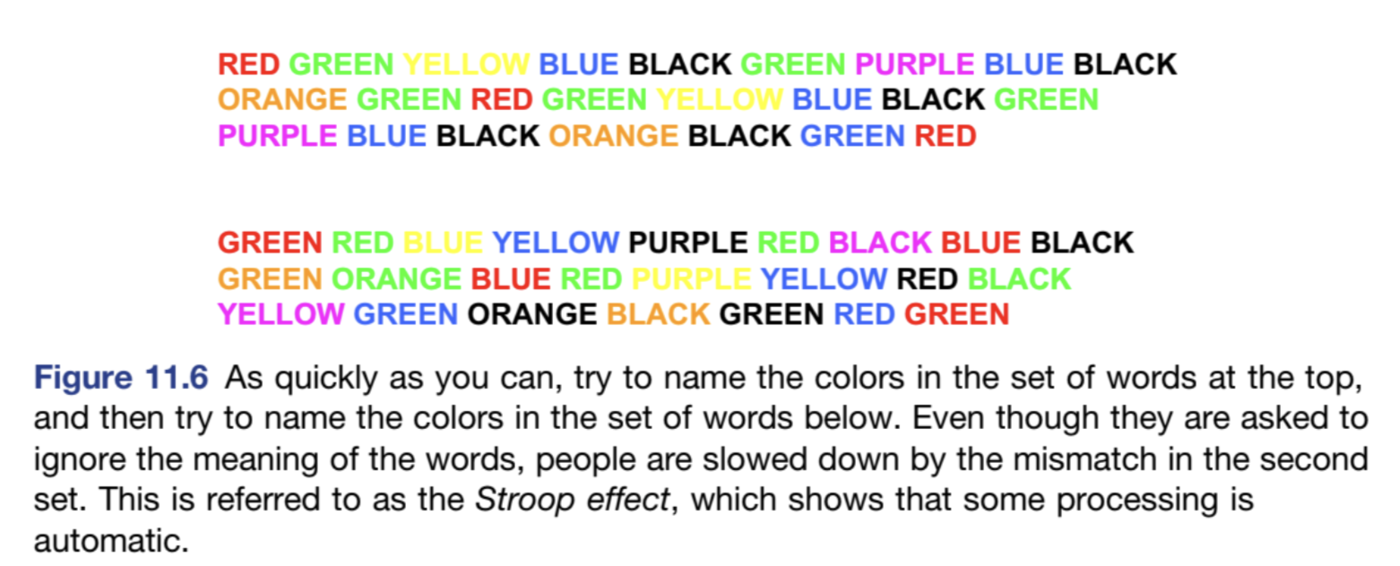
Example for limitations

Slide 12
Change blindness
According to ware, change blindness is a phenomenon in which people fail to detect changes in their visual environment.
change blindness occurs because of the limited capacity of visual attention and how that visual information is processed in the brain.
Ware talks about it as a factor to consider when developing visualizations as iconic and other short term memory stores are limited in their retention time, and info starts to decay at 200 ms and lost 90% at 400 ms.
This is why you don’t remember dreams.

Slide 13
Spatial Information
Ware describes transfer of visual information, more specifically spatial information that need to be transferred from one fixation to the next in the short span of time.
The easier parallel that can be drawn is the memory map games, where one person is shown the entire deck of tiles and asked to match one tile with the other.
Even though one has seen all the tiles, while trying to solve a problem the field of vision and cognitive processes dial in and forget nonessential information from the perspective of survival.

Slide 14
Attention
Ware talks about attention with the context of visual analytics.
He describes how people don’t notice changes in their environment unless they are consciously looking for it. i.e If unaware of potential changes we won't notice the pattern if it happens.
Ware talks about how we serially process limited visual information, at the rate of 2-6 simple objects per fixation.
He advocates engaging the analyst with proper visualization methods

Slide 15
Long Term Memory
Long term memory has evolved this way to filter out unnecessary information from crucial information.
Imagine if one remembered everything they saw or heard throughout their life, it is overwhelming amount of information to shift through
So, the brain tries to economize the knowledge transfer by using memory registers to read understand and execute on information without transferring it to long term.
Once the need is proven via other systems in the body such as and adrenal glands, knowledge transfer to long term is committed.

Slide 16

Long Term Memory
Easiest way to understand interaction of different types of memory is demonstration.
When you see the photo on the right and notice the details, eg – chocolate chips etc.
One is able to guess how it tastes like, this is an example of long term memory providing instant context to the situation at hand. The concept of cookies is what caused that.

Slide 17
Object Files, Coherence Fields, and Gist.
Object Files: Symbolic representations of everyday, containing both semantic and non semantic information of things around, stored economically.
Coherence Fields: The relational metadata of the object files, arrangement of object files, an index essentially.
Gist: A combination of object files and coherence,
Context: Long term memory consists of both visual and relevant nonvisual object information. This is so that context can be given quickly to new visual information.

Slide 18
Long Term memory
The author mentions that a visual query can be held in working memory, forming the basis for active visual search, through the control of attention.
After information has been transferred to working memory, deeper semantic coding is needed to transfer the knowledge to long term.

Slide 19
Conclusion
In this chapter 11 of the book, Ware details the human cognitive system in the context of consuming and understanding visual stimulus.
He describes the function of the brain-eye system in perceiving the world around us.
The book recommends visualization tools and libraries to tap into the visual thinking process of humans as it’s very economical by default.

Slide 20
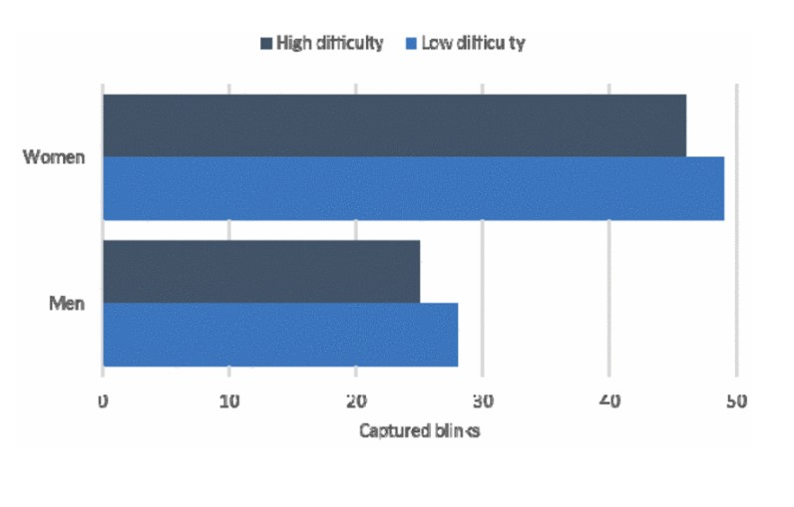
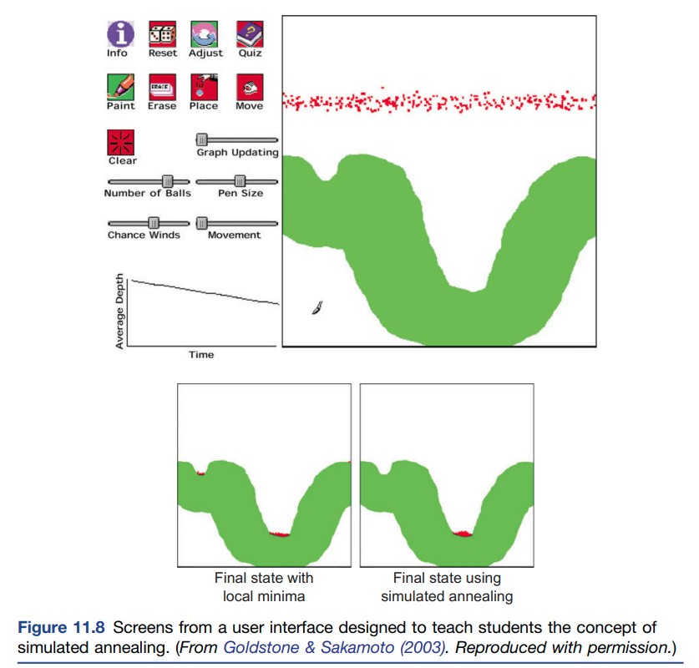
Examples of attention and learning.

Slide 21
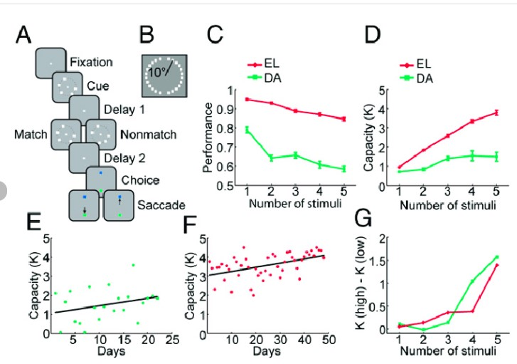
More examples, but with monkeys.

